Slide 1
Frontend
React SPA
Web-Based IoT Device
Real-Time Monitoring System
IoT
Backend
C#, ASP.NET Core, REST API
Database
SQL Server
CAPSTONE PROJECT
BAS — Application Development
Instructor | Naser Chowdhury
Student | Quoc Bao Tran
Real-Time
SignalR
IoT messaging
MQTT
Notes:
Good evening, My name is Quoc Bao Tran, and this is my capstone project for the BAS Application Development program
The project is a Web-Based IoT Device Real-Time Monitoring System: a web application that monitors sensors in real time, stores historical data, raises alerts, and controls actuators remotely. It is aimed at sites that need equipment monitoring without the cost and lock-in of traditional SCADA (Supervisory Control and Data Acquisition) software

Slide 2
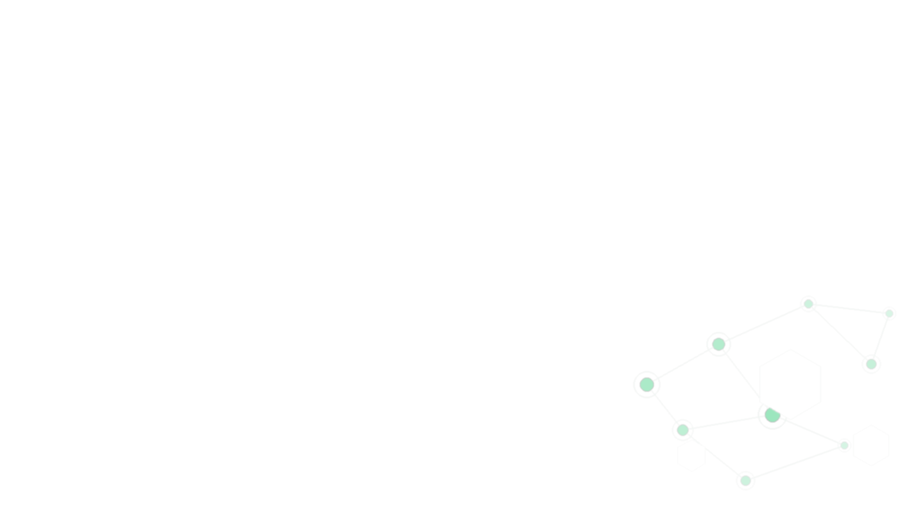
Presentation Agenda
01
Problem Statement
05
Database Design
09
Live Demo
Why IoT monitoring matters in industrial settings
Devices, sensors, readings, alerts
Edge → API → SignalR → Dashboard
02
Project Goals & Scope
06
Backend & API
10
Challenges & Solutions
Objectives, requirements, boundaries
Services, repositories, DTOs
Sync, data volume, design
03
Technology Stack
07
Frontend Design
11
Conclusion & Future
C#, ASP.NET Core, React, SQL Server
React SPA, charts, SignalR client
04
System Architecture
08
Key Features
End Of Presentation
Edge → MQTT → API → DB → SignalR → React
Streaming, dashboards, alerts
Notes:
Here is the roadmap for today’s presentation.
I will start with the problem statement, explaining why real-time IoT monitoring is important in industrial environments. Then, I will introduce the project goals and scope, including what the system is designed to achieve.
Next, I will cover the technology stack and system architecture, showing how data flows from the edge device through MQTT, the API, the database, SignalR, and finally to the React frontend.
After that, I will explain the database design, followed by an overview of the backend, API layer, and frontend design.
I will then highlight the key features and present a live demo, where you will see sensor data travel from the edge device to the dashboard in real time.
Finally, I will discuss the challenges we faced, the solutions we implemented, and conclude with future work.
Let’s begin with the problem statement.

Slide 3






Project Statement
Web-Based
Any Browser
Need
Sites need continuous equipment monitoring.
No proprietary hardware required
Accessible from any device
Issue
Traditional lock into proprietary hardware and software, cost.
Real-Time
Cost-Effective
SignalR / WebSocket
Realtime Update
Open-source technology stack
Approach A web dashboard with real-time data, historical storage, and standard IoT hardware.
SQL Server
Hardware
Full historical data storage
Arduino, ESP32, Raspberry Pi
Notes:
Many facilities, including hotels, hospitals, farms, warehouses, and manufacturing plants, need to continuously monitor equipment and sensor data.
Traditional monitoring systems can be expensive and often lock organizations into proprietary hardware and software.
To address this, this project provides a web-based dashboard that runs in any browser and uses common IoT devices together with technologies such as ASP.NET Core, React, MQTT, SignalR, and SQL Server.
The result is a practical and cost-effective solution for real-time monitoring and historical data storage.

Slide 4






Project Goals & Scope
CORE SYSTEM CAPABILITIES
Devices & Sensors Setup
Dashboard & Charts
Register and configure IoT Devices
Gauge, line trends, discrete indicator
Real-Time Monitoring
Threshold Alerting
Live sensor reading & Device on/off-line status
Rule-based alerts with real-time notifications
Live & History Window
Actuator Commands
Store readings & rolling time windows
Remote output control with command history
Notes:
These six capabilities define the scope of the system and support the complete monitoring workflow.
The process begins with device and sensor setup, where users register IoT devices and configure sensors and actuators within the application.
Once connected, the system provides real-time monitoring, displaying live sensor readings and device online or offline status.
The collected data is stored and presented through live and history views, as well as dashboards and charts that help users track trends and monitor system performance over time.
When sensor values exceed predefined limits, the threshold alerting feature generates real-time notifications.
Finally, actuator commands allow users to remotely control devices while maintaining a command history for traceability.
Together, these capabilities enable users to configure, monitor, and respond from a single web application.

Slide 5


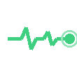


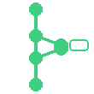
Technology Stack
Device → MQTT → API → SQL Server . SignalR → UI
Backend
IoT Messaging
Real-Time
C# / ASP.NET Core 8
MQTT + Broker (Mosquitto/EMQX)
SignalR
Rest APIs, MQTT Ingest, JWT Authentication
Server-to-client live sensor and alert updates
Device → Broker → Backend; Command to Actuator
Frontend
Database
DevOps
React + TypeScript
SQL Server + EF Core
Git + GitHub + Azure
Dashboard, live chart, gauge, device management UI
Sensor readings, devices, alerts, command history
CI/CD: API (Azure Web App) + SPA (Static Web Apps)
Notes:
This slide presents the main technologies used in the project.
The backend is built with ASP.NET Core, which provides REST APIs, MQTT data ingestion, and JWT-based authentication.
For device communication, the system uses MQTT with a Mosquitto broker. MQTT stands for Message Queuing Telemetry Transport, a lightweight messaging protocol commonly used in IoT systems. It enables devices and sensors to efficiently send data to the backend in real time.
Real-time updates are delivered through SignalR. SignalR allows the server to instantly push sensor readings and alerts to connected users without requiring the browser to refresh the page.
The frontend is developed using React and TypeScript, providing dashboards, charts, and device management interfaces.
SQL Server is used for data storage, while GitHub and Azure support version control, CI/CD, and cloud deployment.
Together, these technologies form a complete stack for real-time IoT monitoring.

Slide 6
System Architecture Overview
External Systems
Frontend
Backend
Data Layer
Operator
Web Browser
React SPA
(MUI + React Router)
REST Controllers
Devices, Sensors,
SensorReadings,
Alerts, AlertRules,
Health
Application Services
DeviceService
SensorService
SensorReadingService
AlertService
AlertRuleService
IoT Devices
/Gateway
REST client
(api.ts )
Repositories
SignalR client
(signalRService.ts)
MonitoringHub
(SignalR)
SignalRNotificationServices
SQL Server
MQTT
Broker
MqttService
ApplicationDbContext
Notes:
This diagram shows how the different components interact within the system.
IoT devices publish sensor readings to the MQTT broker. The MQTT service in the backend subscribes to these messages, processes the data, and forwards it to the application services.
The application services contain the core business logic and work with repositories to store and retrieve data from SQL Server through the ApplicationDbContext.
For client communication, REST controllers handle configuration, device management, and historical data requests, while SignalR delivers real-time updates to connected users.
On the frontend, the React application uses REST APIs for configuration and historical data, and SignalR for live sensor readings and alerts.
As a result, operators only need a web browser to monitor devices, view historical trends, receive alerts, and interact with the system in real time.

Slide 7
Database Schema Map
11 tables • Devices = central hub • Key fields and relationships shown
SensorReadings
Sensors
Raw measurements over time
Inputs on each device
0..*
PK
ReadingId
long
PK
SensorId
int
FK
DeviceId
int
FK
DeviceId
int
1
0..*
FK
SensorId
int
SensorName
string(100)
Value
dec(18,4)
SensorType
string(50)
0..*
0..1
0..1
0..1
DeviceStatusHistories
0..*
1
Device status change log
Devices
0..*
PK
StatusHistoryId
long
HUB
1
FK
DeviceId
int
Actuators
IoT equipment registry
Status
string(50)
Controllable outputs
1
PK
DeviceId
int
1
Timestamp
DateTime
PK
ActuatorId
int
0..*
DeviceName
string(100)
FK
DeviceId
int
DeviceType
string(50)
1
FK?
FeedbackSensorId
int?
1
IsActive
bool
0..*
OperationalMetrics
Kind
string(20)
1
0..1
1
Calculated KPIs per device
0..1
PK
MetricId
long
FK
DeviceId
int
MetricType
string(50)
0..*
0..*
0..*
0..*
MetricValue
dec(18,4)
Users
0..*
0..*
DeviceConfigurations
DeviceCommands
AlertRules
0..*
App login and roles
Per-device settings
Commands sent to device / actuator
Alert / threshold rules
Alerts
PK
UserId
int
PK
ConfigurationId
int
PK
CommandId
long
PK
AlertRuleId
int
0..*
Fired alert records
Username
string(100)
FK
DeviceId
int
FK
DeviceId
int
FK?
DeviceId
int?
1
PK
AlertId
long
Role
string(20)
ConfigurationKey
string(100)
FK?
ActuatorId
int?
FK?
SensorId
int?
FK
AlertRuleId
int
IsActive
bool
ConfigurationValue
string(500)
CommandType
string(50)
Severity
string(20)
FK
DeviceId
int
⊘ standalone — no FK links
FK?
SensorId
int?
Hub (Devices)
Primary entities
Event / log tables
Configuration
1
required (1)
0..1
optional (0..1)
0..*
many (0..*)
Notes:
This diagram shows the database schema used by the system.
The database consists of eleven normalized tables, with Devices serving as the central entity. Most other tables are connected to a device, allowing the system to manage multiple devices within a single platform.
Each device can have multiple sensors for data collection and multiple actuators for control actions. SensorReadings stores time-series sensor data, while DeviceStatusHistories records device connectivity and status changes over time.
For monitoring and control, AlertRules define alert conditions, Alerts store alert events, and DeviceCommands maintain a history of commands sent to actuators.
Additional tables, such as DeviceConfigurations and Users, support system configuration, authentication, and access control.
Overall, the schema is designed to support monitoring, alerting, and device control while maintaining clear relationships and data integrity.

Slide 8
Backend & API Design
Layered architecture · RESTful APIs · real-time streaming
Base: https://host/api/v1
Presentation Layer
Device APIs
Alert Rules
1
GET
/devices
GET
/alertrules
Controllers · SignalR Hub
GET
/devices/{id}
GET
/alertrules/{id}
POST
/devices
GET
/alertrules/devices/{deviceId}
PUT
/devices/{id}
POST
/alertrules
↓
DELETE
/devices/{id}
PUT
/alertrules/{id}
GET
/devices/{id}/status
DELETE
/alertrules/{id}
Sensor APIs
Actuators & Commands
2
Service Layer
GET
/sensors/devices/{deviceId}/sensors
GET
/actuators/devices/{deviceId}/actuators
Business Logic · Validation
GET
/sensors/{id}
POST
/actuators/devices/{deviceId}/actuators
POST
/sensors/devices/{deviceId}/sensors
PUT/DELETE
/actuators/devices/{deviceId}/actuators/{id}
PUT
/sensors/{id}
POST
/devices/{deviceId}/commands
↓
DELETE
/sensors/{id}
GET
/devices/{deviceId}/commands
GET
/commands/{commandId}
Sensor Readings — Core IoT
POST
/sensorreadings
Auth & Health
3
Data Access Layer
POST
/sensorreadings/batch
POST
/auth/login
GET
/sensorreadings
GET/POST
/auth/users · /auth/change-password
EF Core · Repository Pattern
GET
/sensorreadings/{id}
DELETE
/auth/users
GET
/sensorreadings/devices/{deviceId}/readings
GET
/health · /health/mqtt
GET
/sensorreadings/sensors/{sensorId}/readings
↓
Device Configuration
Alert APIs
GET
/devices/{deviceId}/configurations
GET
/alerts
PUT
/devices/{deviceId}/configurations
Database Layer
GET
/alerts/active
4
GET
/alerts/{id}
SQL Server · IoTMonitoringDB
PUT
/alerts/{id}/acknowledge
PUT
/alerts/{id}/resolve
⚡ MQTT → Broker → API → SignalR → Frontend (<2s real-time updates)
🔐 Most endpoints [Authorize] · Admin / Operator on writes · JWT Bearer · SignalR: ?access_token
Notes:
This slide shows the backend architecture and the REST APIs exposed by the system.
The backend follows a layered architecture consisting of a presentation layer, service layer, data access layer, and database layer. This separation helps keep the application maintainable and scalable.
The APIs are organized into several functional groups. Device, Sensor, and Device Configuration APIs support system setup and management. Sensor Reading APIs handle data ingestion and historical queries. Alert Rule and Alert APIs manage alert configuration and alert processing. Actuator and Command APIs support remote device control and command tracking. Authentication and Health APIs provide security and system monitoring functions.
Most endpoints are protected using JWT authentication with role-based access control for Administrators, Operators, and Viewers. SignalR connections use the same authentication mechanism.
For real-time monitoring, sensor data travels from the device through MQTT and the broker to the API, where SignalR pushes updates to connected clients, typically within one to two seconds.

Slide 9
Frontend Design | Components & Navigation
App shell · ProtectedRoute guard · 10 route-level pages · JWT role-based routing
Routes & Navigation
LoginPage
Route
Page
Note
/login
LoginPage
Public
JWT login · public
Navigation
Shared
/dashboard
Dashboard
Live overview · SignalR charts
Protected
Dashboard
/devices
DevicesPage
Device CRUD
App.tsx
Protected
DevicesPage
/devices/:id
DeviceDetailPage
Protected
Live chart + sensors + commands
DeviceDetailPage
/sensors
SensorsPage
Protected
All sensor inputs
SensorsPage
/actuators
ActuatorsPage
Protected
Controllable outputs
ProtectedRoute
ActuatorsPage
/alert-rules
AlertRulesPage
Protected
Threshold rule config
AlertRulesPage
/alerts
AlertsPage
Protected
View · acknowledge · resolve
/command-history
CommandHistoryPage
Protected
Pending → Sent → Acked
AlertsPage
/users
UserManagementPage
Admin
Admin: manage accounts
CommandHistoryPage
UsersPage
Admin
ProtectedRoute redirects to /login if localStorage has no valid JWT
isAdmin() check gates /users — Navigation hides Users link for non-admin roles
Notes:
This slide shows how the frontend application is structured and how users navigate through the system.
The application is built as a React single-page application, meaning users can move between features without reloading the page.
After authentication, users access the system through ProtectedRoute, which validates the JWT token and enforces role-based access control. Administrative functions, such as user management, are only available to authorized users.
Once authenticated, users navigate through a shared navigation layout that provides access to the main system functions, including dashboards, device management, sensors, actuators, alerts, and command history.
The dashboard provides a real-time overview using SignalR updates, while the other pages support monitoring, configuration, alert management, and device control.
Overall, the frontend delivers a consistent and secure user experience for monitoring and managing IoT devices from a single web application.

Slide 10
Key Features
Core capabilities mapped directly to system architecture and real-world needs
Setup & control
Devices, sensors, and actuators
Online/offline from last device activity
Sensor setup: type, unit, limits, chart style
MQTT commands with command history
Real-time streaming
SignalR push for readings and alerts
~1–2 s UI updates, no refresh
Multi-device hub subscriptions
Rolling live charts (2s–30m time windows)
Alerting
Threshold, range, and change rules
Live alert notifications via SignalR
Acknowledge and resolve workflow
Alert history stored in database
Dashboard & visualization
Charts line trends and analog gauges
Discrete on/off sensor indicators
History: 10m, 1h, 24h, custom range
Responsive Material-UI dashboards
Notes:
This slide summarizes the key capabilities delivered by the system.
The first area is setup and control, where users can configure devices, sensors, and actuators, monitor device connectivity, and send commands with full command history tracking.
The second area is real-time monitoring. Sensor readings and alerts are streamed to the dashboard with near real-time updates, allowing users to monitor multiple devices without refreshing the page.
The third area is dashboard visualization. Users can view live charts, analog gauges, discrete status indicators, and historical data across multiple time ranges.
Finally, the alerting feature supports threshold, range, and change-based rules, with live notifications, acknowledgment workflows, and historical alert tracking.
Together, these features provide a complete solution for monitoring, alerting, and controlling IoT devices through a single web application.

Slide 11
Live Demo
Watch one sensor reading travel the full stack — from edge device to dashboard — in real time.
DEMO CHECKLIST
# | Step | Show
1 | Register device; add sensors/actuators; alert rule | Dashboard configured
2 | Connect Arduino; run firmware (local MQTT) | Serial + broker connected
3 | Open Live chart | Line updates ~1/s
4 | Send actuator command | LED on/off; command history
5 | Breach threshold | Alert appears (SignalR)
6 | History range (e.g. 10m) | Stored readings in chart
11 / 14
Notes:
I will now demonstrate the complete workflow of the system.
The demo will begin with a configured device connected through MQTT. I will then show live sensor readings updating on the dashboard, send a command to an actuator, trigger an alert condition, and finally review the historical data stored in the database.
This demonstrates the full path from the physical device to real-time visualization, alerting, and remote control within the application.

Slide 12

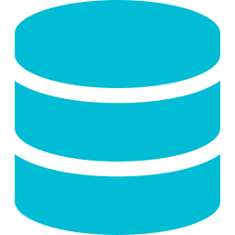


Challenges & Solutions
Engineering decisions that address specific technical challenges.
Real-Time Data Synchronization
High-Volume Time-Series Storage
Challenge Multi-client live sync without polling.
Challenge Fast queries on growing reading table.
Solution SignalR groups; push after save.
Solution BIGINT key, indexes, paged date filters
Cross-Layer Data Flow Design
Edge Device Compatibility
Challenge Clean path from device to chart
Challenge Same backend API for multiple edge platform
Solution MQTT → API → DB → SignalR → React
Solution MQTT + JSON, REST for tests, shared device model: device/sensor
12 / 14
Notes:
During development, several technical challenges influenced the system design.
The first challenge was real-time synchronization. Multiple users may monitor the same devices at the same time, so the system needs to keep all clients updated without constant polling. This was addressed using SignalR, which pushes updates to connected clients whenever new data is received.
The second challenge was storing and querying large volumes of sensor data efficiently. To support historical analysis, the database was designed with appropriate indexing and query strategies to maintain performance as the number of readings grows.
Another challenge was maintaining a clear and reliable data flow across multiple layers of the system. A consistent pipeline from MQTT to the API, database, SignalR, and frontend helps keep the architecture organized and maintainable.
Finally, the system needed to support different edge platforms, including Arduino, ESP32, and Raspberry Pi. This was achieved through a shared communication model using MQTT and JSON, allowing different devices to interact with the same backend services.
Together, these design decisions improved scalability, maintainability, and interoperability across the platform.

Slide 13


Conclusion & Future Work
What we delivered → What comes next
What we achieved
Future enhancements
✓ End-to-end IoT platform ✓ 11-table database schema ✓ ASP.NET Core API & JWT security ✓ Real-time monitoring with SignalR ✓ React dashboard & device control ✓ Edge device integration (Arduino) ✓ Azure cloud deployment
Data retention & archiving
Multi-tenant support
Mobile application
AI anomaly detection
More edge device integrations
Production scalability
Notes:
This project successfully delivered a complete end-to-end IoT monitoring platform.
The system provides real-time monitoring, alerting, historical data storage, and remote device control through a single web application. It also includes device integration, role-based security, and cloud deployment using GitHub and Azure.
Looking ahead, future enhancements could include automated data retention and archiving, multi-tenant support, a mobile application for field operators, machine-learning-based anomaly detection, and broader device integration.
Overall, this project demonstrates a practical full-stack IoT solution that connects physical devices to a real-time web dashboard and applies the knowledge gained throughout the BAS Application Development program.

Slide 14
Thank You
I would like to express my sincere gratitude to the instructors, especially Naser Chowdhury, for their guidance and support throughout the past two years. I would also like to thank RTC School for giving me the opportunity to achieve my first educational milestone in the United States, and my classmates and colleagues for their hard work, dedication, and support as we balanced work and study together to reach this achievement.
End Of Presentation

